Slide 1
Ionic Compounds
An ionic compound results when a metal is attracted to a nonmetal
The metal becomes positive because they have a tendency to lose electrons
The nonmetal becomes negative because they have a tendency to gain electrons
The result is a compound that is electrically neutral

Slide 2
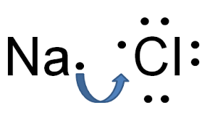
Explain using diagrams how sodium and chlorine react to form an ionic compound.

Slide 3
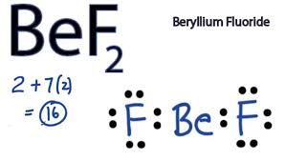
Explain using diagrams how beryllium and fluorine react to form an ionic compound.

Slide 4
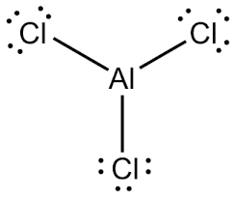
Explain using diagrams how aluminum and fluorine react to form an ionic compound.

Slide 5
Multivalent Elements
Certain elements have multiple ionic charges:
Metal | Symbol | Ion | Name of Ion
copper | Cu | Cu⁺ Cu²⁺ | copper (I) copper (II)
iron | Fe | Fe²⁺ Fe³⁺ | iron (I) Iron (III)
lead | Pb | Pb²⁺ Pb⁴⁺ | lead (II) lead (IV)
manganese | Mn | Mn²⁺ Mn⁴⁺ | manganese (II) manganese (IV)
tin | Sn | Sn²⁺ Sn⁴⁺ | tin (II) tin (IV)

